Slide 1

Contact:
djacobs1@uncc.edu
Modeling Protein Stability and Exploring Conformational Ensembles
Donald Jacobs, Professor
Department of Physics and Optical Science
First CIIT International Spring School on
Computational Materials, Research and Education

Slide 2
The BioMolecular Physics Group
People and funding over the years
Collaborators
Dennis Livesay
Irina Nesmolova
Jerry Troutman
Chris Yengo (PSU)
Jörg Rösgen (PSU)
Russ Middaugh (KU)
Aron Fenton (UKMC)
Post Doctoral Fellows
Amit Srivastava
Former:
Research Associates
Oleg Vorov
Jim Mottonen
Former:
Postdoctoral Fellows
Tong Li
Chuanbin Du
Hui Wang
Andrei Istomin
Greg Wood
Sargis Dallakayan
Former:
Students
Alicia Heckathorne
Dang Huynh
Jeremy Hules
Moon Lee
Shelley Green
Mike Fairchild
Shira Stav
*Chuck Herrin
*Luis Gonzalez
Charles David
*Deeptak Verma
Wei Song
Alex Rosenthal
*Samantha Dodbele
*Terry Rabinowitz
Current Students
Jenny Farmer
Chris Singer
Aaron Brettin
*Matt Brown
*Brittany Smith
*Ellie Okwei
Kebba Mybe
High School students
Sunny Potharaju
Aniket Palkar
Work supported by:
Research Corporation CC5141
NIH-S06 GM48680-0952, NIH-R01 GM 073082
NIH-R21 HL093531, NIH-ARRA-073082
NIH-S10 SRR026514, MedImunne, Inc.
Charlotte Research Institute (CRI)
Center for Biomedical Engineering and Science (CBES)

Slide 3

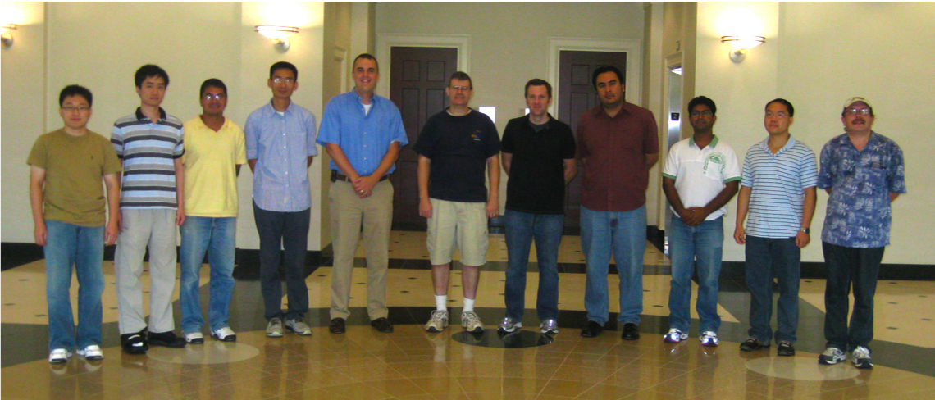
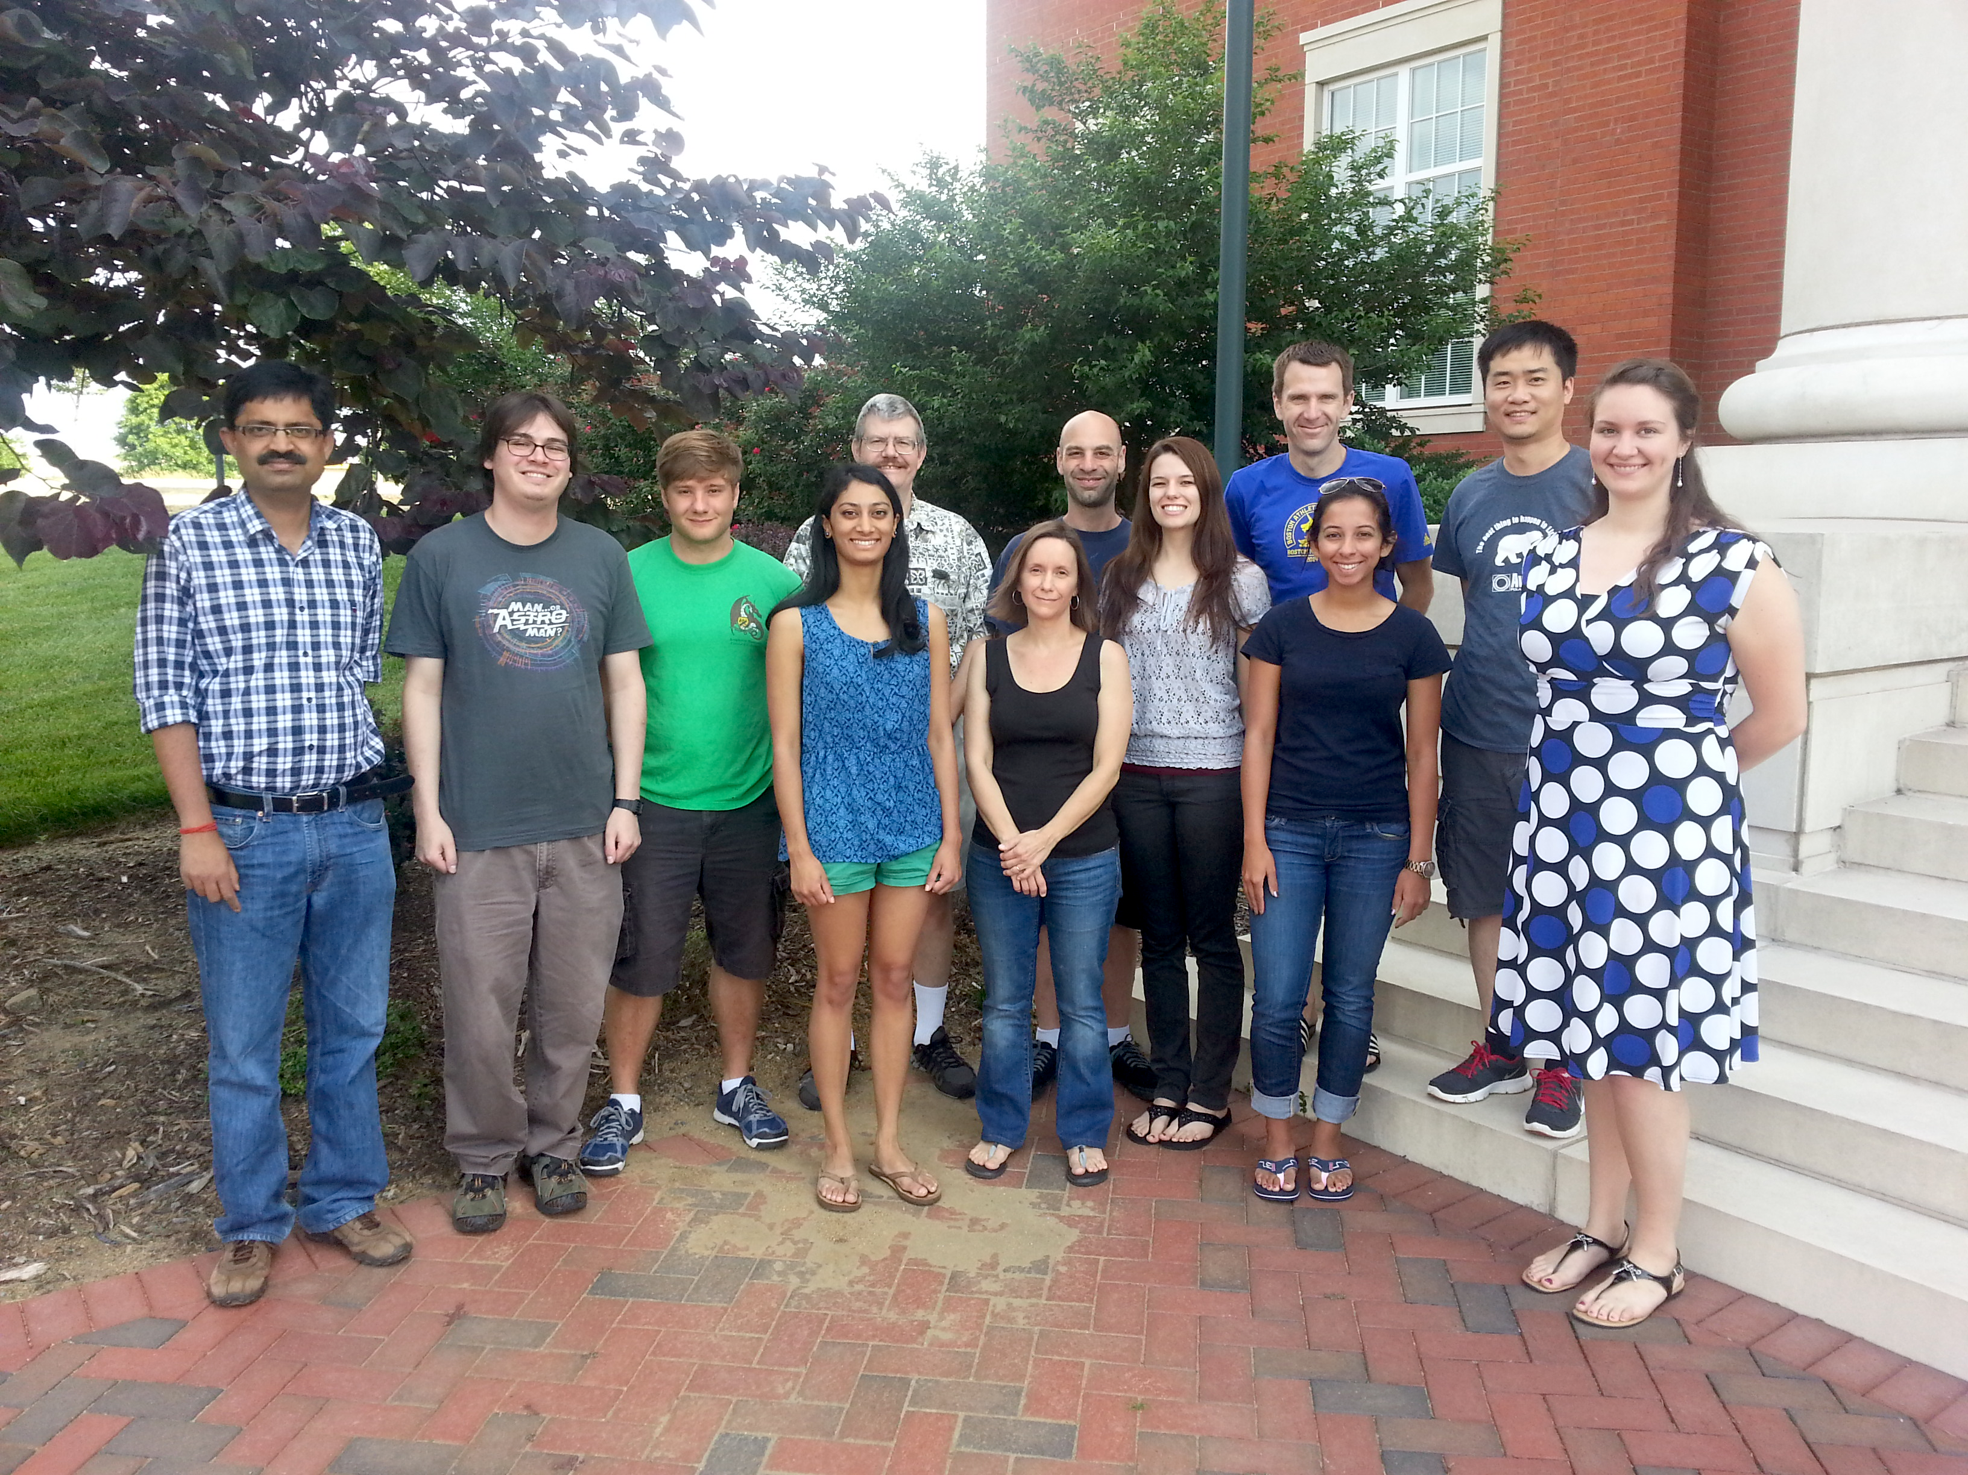
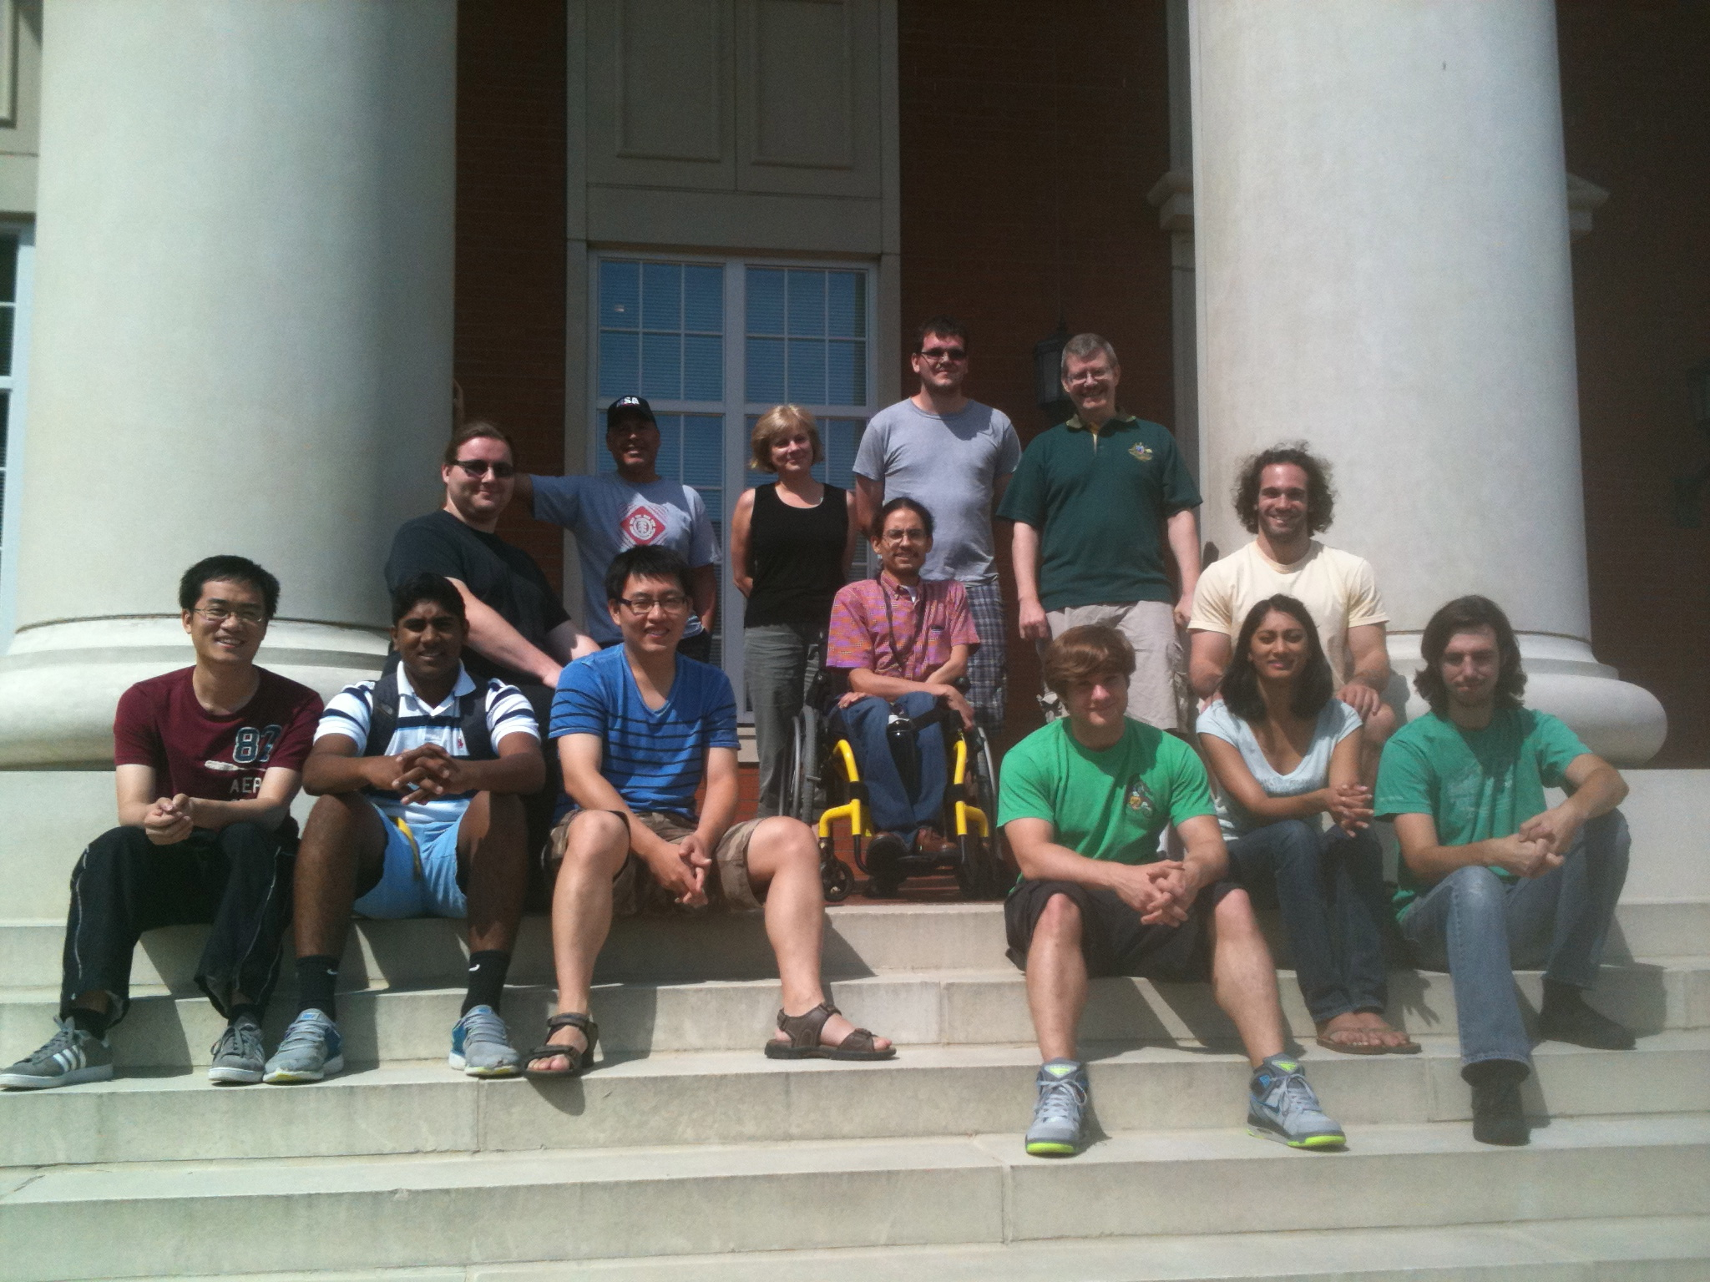
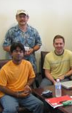
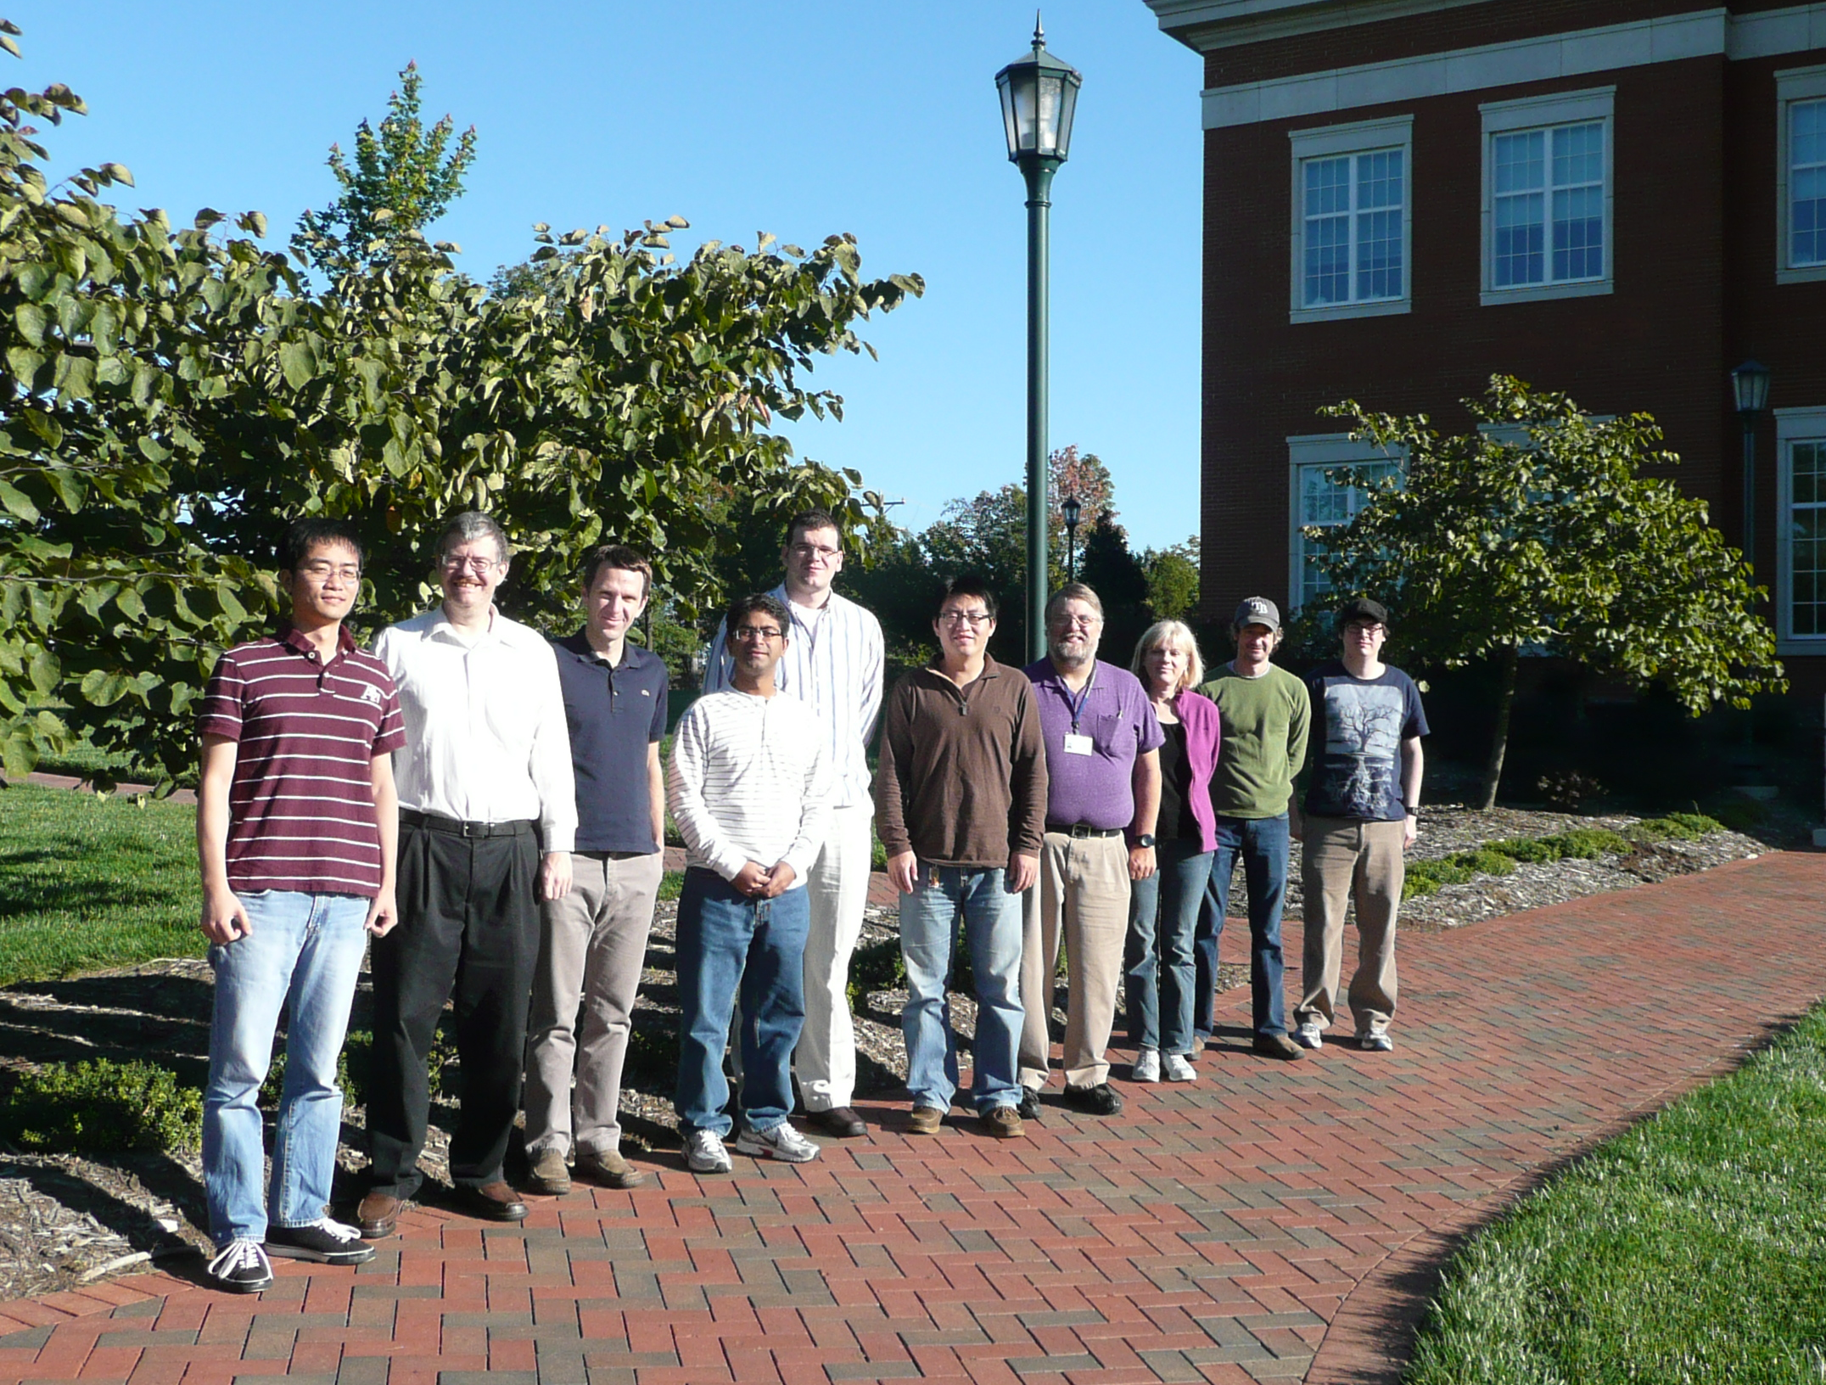
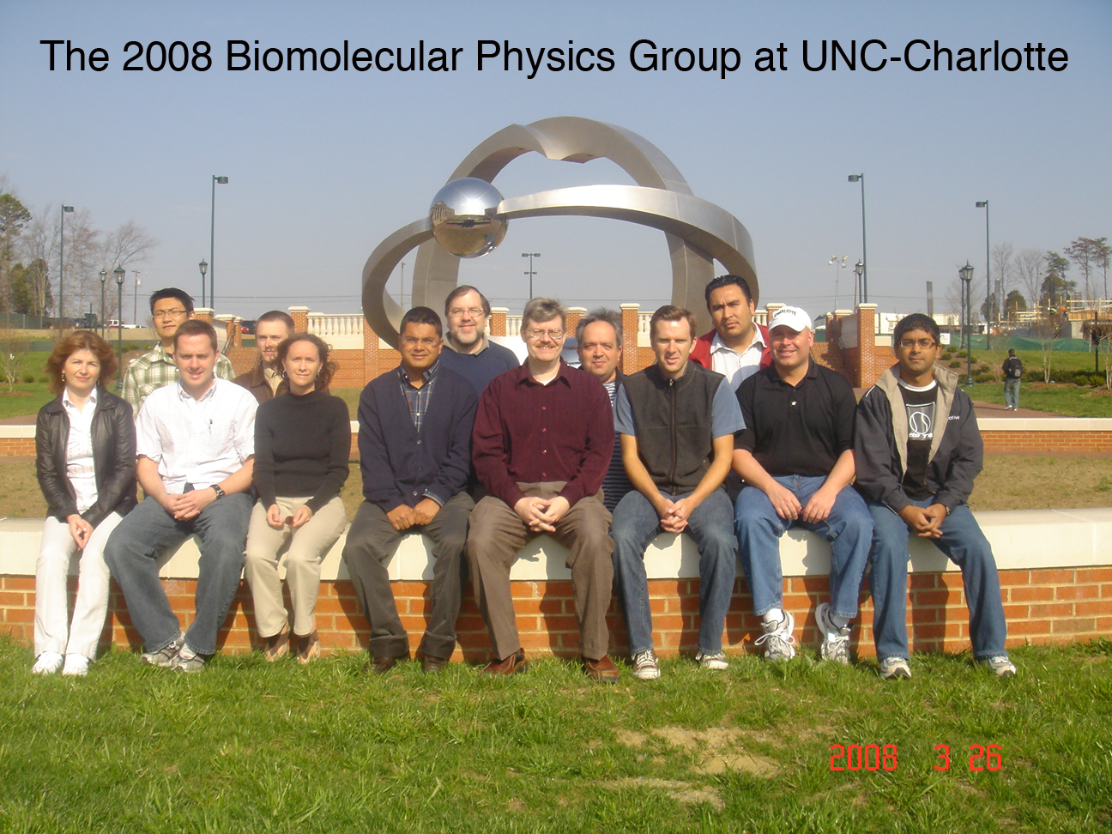
BioMolecular Physics Group
2010 BMPG and friends at UNC-Charlotte
Summer 2014
Summer 2013
Summer 2012
Spring 2008

Slide 4
Outline: 6 Part Lecture
Part 1: Introduction
Motivation: Why Study Proteins?
Protein Chemistry: Structure, Dynamics, Stability
Constraint Theory and network rigidity
Free Energy Decomposition and Reconstitution
Distance Constraint Model (DCM)
Part 2: Exact Numerical Solutions for the DCM
Simple toy model
Beta-hairpin to coil transition
Transfer matrix method under Maxwell constraint counting
Alpha-helix to coil transition (in water)
Alpha-helix to coil transition (in mixed solvent)

Slide 5
Outline: 6 Part Lecture
Part 3: Monte Carlo + Free Energy Functional Method
Protein stability employing a minimal DCM (mDCM)
Selected application highlights
Part 4: Body-bar pebble game
Virtual pebble games
Part 5: Exploring Conformational Ensembles
Computational trade offs (accuracy versus speed)
Geometric Simulation (GS)
mDCM-GS hybrid
Free energy driven simulations

Slide 6
Outline: 6 Part Lecture
Part 6: Promising Research Directions
Self-Consistent Constraint Theory (SCCT)
FAST software for Flexibility And Stability Test
Multicomponent solvent
System of proteins
Polymeric materials

Slide 7
Part 1
Introduction

